Slide 1

Dynamics of an Epidemic Network Model
Hitesh Bahar
Matthew Mietchen

Slide 2
Background
Antimicrobial Resistance (AMR) is a major challenge
i.e. MRSA (methicillin resistant staphylococcus aureus)
Disease transmission in hospitals are difficult to study
Disease models help to understand transmission dynamics
Pathogen colonization vs infection
Intra-hospital vs inter-hospital transmission
Pathogen transmission within a hospital is extremely complicated
Creates a meta-population structure

Slide 3
Intra-hospital SIS model
Mrsa Transmission Stochastic Compartmental model
S (susceptible) – uncolonized patients
I (Infected) – colonized patients
Model assumptions
Homogenous mixing (mass action) of patients
Patients are only colonized by other patients
Colonized patients are not treated (natural de-colonization only)
Closed hospital model

Slide 4






Intra-hospital SIS model
$$\text{μ}$$
Parameters
𝛃 (beta) – Colonization Rate
𝛄 (gamma) – Decolonization rate
𝛉 (theta) – Death or Discharge
𝛍 (mu) – Admissions who are colonized
S_{𝒊}
$$θ$$
$$\text{β}$$
$$\text{γ}$$
I_{𝒊}
$$θ$$
Patient Transfers
$$\text{μ}$$

Slide 5
Intra-hospital SIS model
Model Analysis & Simulations
Gillespie's Stochastic Simulation Algorithm (SSA)
Generate Simulations of Finite Populations in a continuous Time Model
Model Parameters
100 patients (99 susceptible / 1 infected)
Studied a range of patient colonization rates (R₀)
100 simulations (500 time steps per simulation)

Slide 6
Intra-hospital SIS Model Results

Slide 7
SIS inter-hospital network model
Main Objectives:
Implement sis network model for hospital patient transfers
Study a range of the colonization rates (R₀)
Compare the disease spread across different Random network structures
Erdos-Renyi
Barabasi (Preferential Attachment)
Watts & Strogatz (Small World)
Network Parameters
Initial Infected(%) = 1, Decolonization Rate(Gamma) = 0.002083
Colonization rate (Beta) = 0.00167 - 0.0025
Equal probability of Patient Transfer
Hospitals “infect” Hospitals with similar probabilities as patients to patients

Slide 8
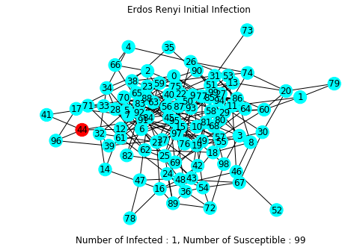
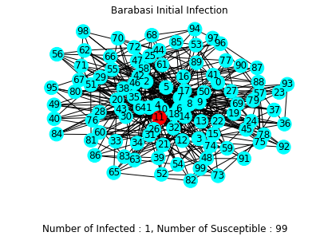
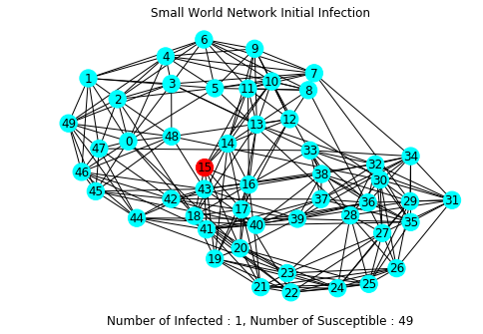
Initial Infection Networks

Slide 9
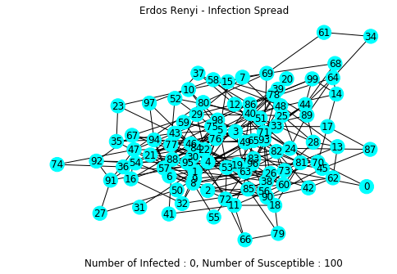
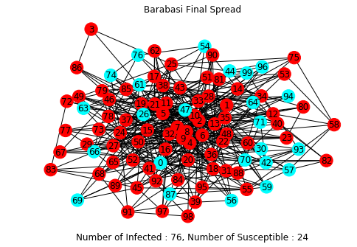
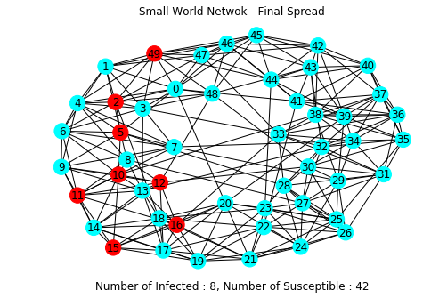
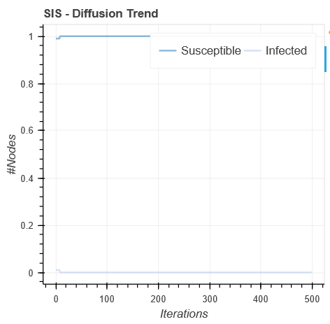
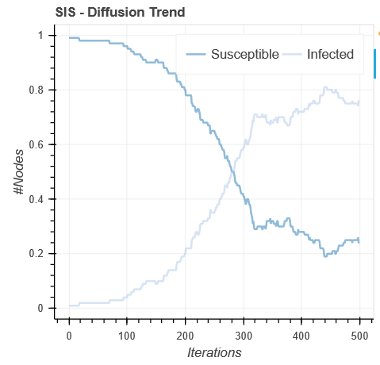
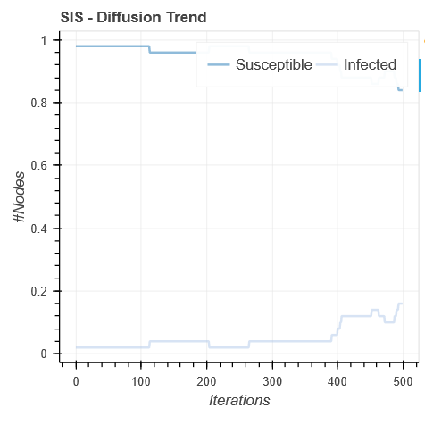
Network Comparison (R₀ = 0.8)

Slide 10
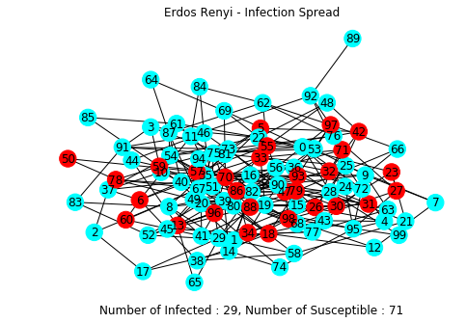
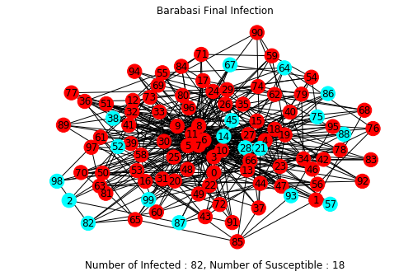
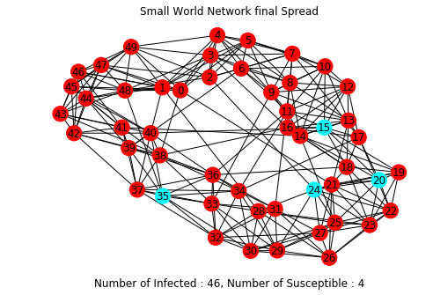
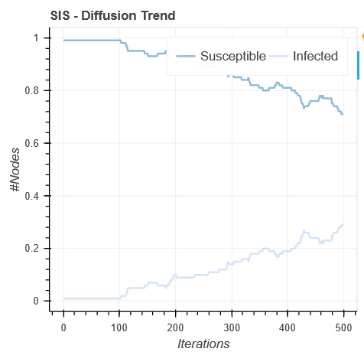
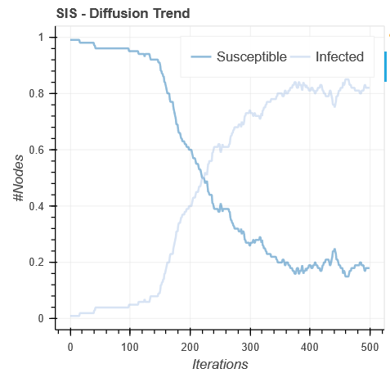
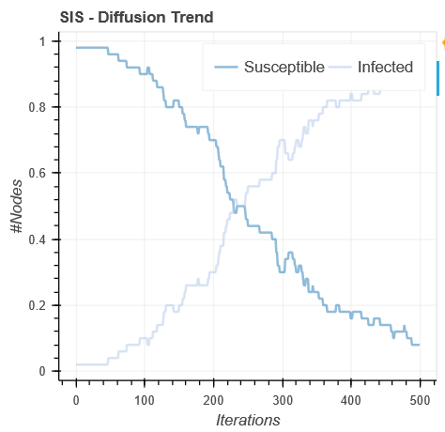
Network Comparison (R₀ = 1.0)

Slide 11
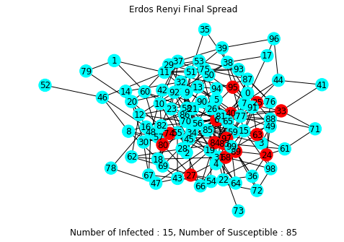
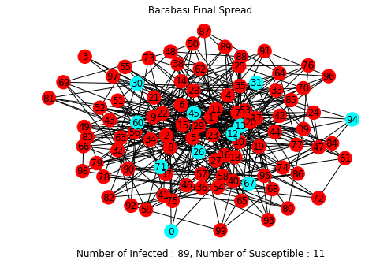
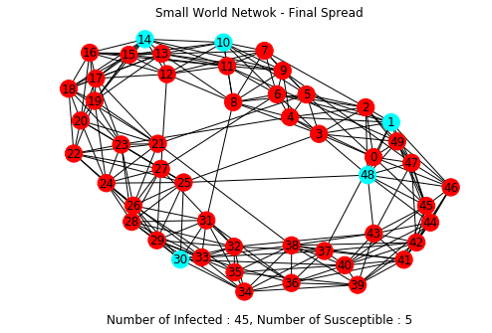
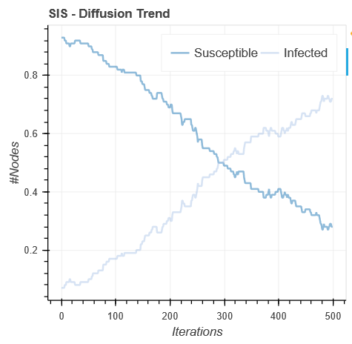
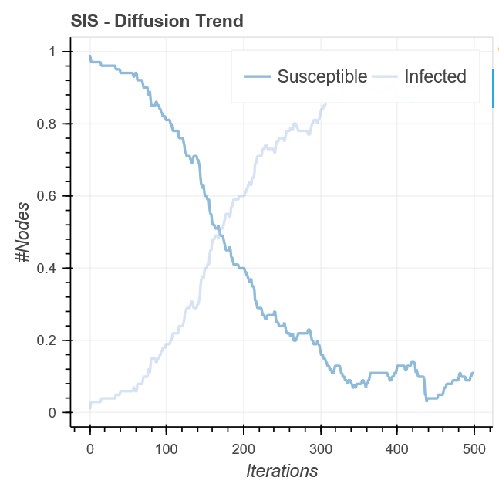
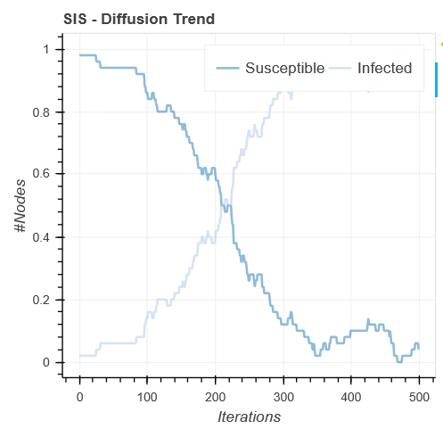
Network Comparison (R₀ = 1.2)

Slide 12
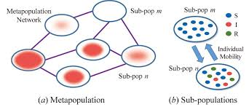
Meta-population network model
Main Question:
Does patient transfers between hospitals have an effect on the Spread of MRSA
Meta-population model structure
Infection spreads within Hospitals
100 hospitals w/ SIS model per hospital
Patient Transfers link the hospitals
probability of a colonized patient being transferred (per day)

Slide 13
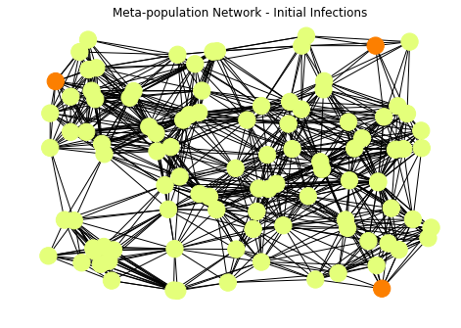
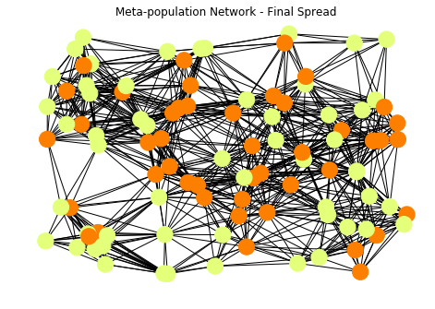
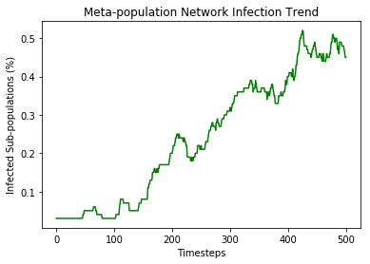
Meta-population results
Nodes/Patches with Status Susceptible (0) and Infected (1)
How close two patches should be allow transmission to occur
Patch colonize its neighbors, and check colonization occur.

Slide 14
Discussion & challenges
Discussion
Disease transmission within a hospital is dependent upon the Reproduction Rate (R₀)
Network structure seems to play a role on disease transmission
More highly structured graphs allow spread to happen faster
Barabasi network findings
A Relatively low R₀ can have large impacts
Time until an epidemic begins and the rate of spread seem important in the models
Challenges
Connecting many sis epidemic models across a network proves challenging

Slide 15
Next steps / future work
Further investigate the network structures by increasing time steps and simulations
Finalize the implementation of the SIS models in a Meta-Population Network
Study dynamics of disease spread across a meta-population network

Slide 16
Thank you Hitesh Bahar hitesh.bahar@wsu.edu Matthew Mietchen matthew.Mietchen@wsu.edu

